Slide 1
MediCall
Fall 2018: BME Senior Design
Deepthi Nacharaju
Lizbeth Leapo
Haeryn Kim

Slide 2
Introduction

Slide 3
Specifications

Slide 4
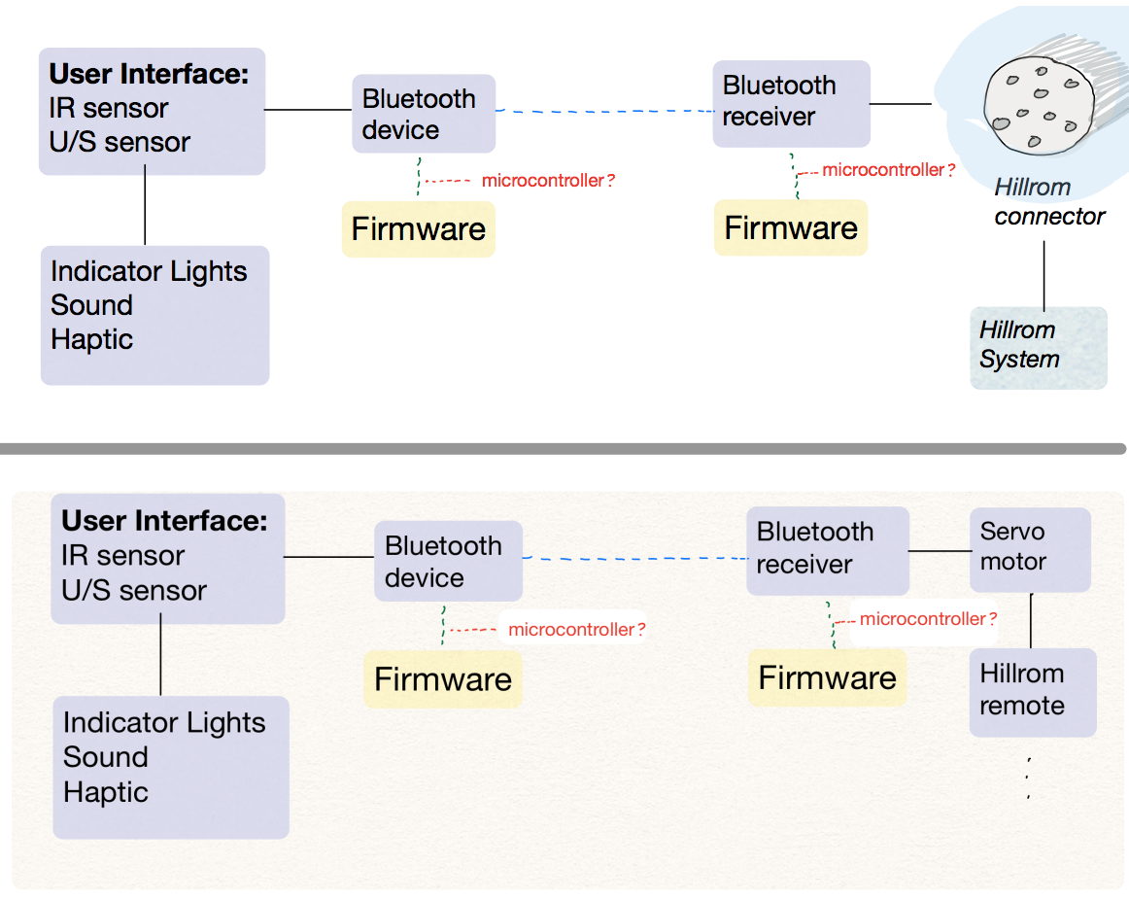
Objectives: Functional Decomposition

Slide 5
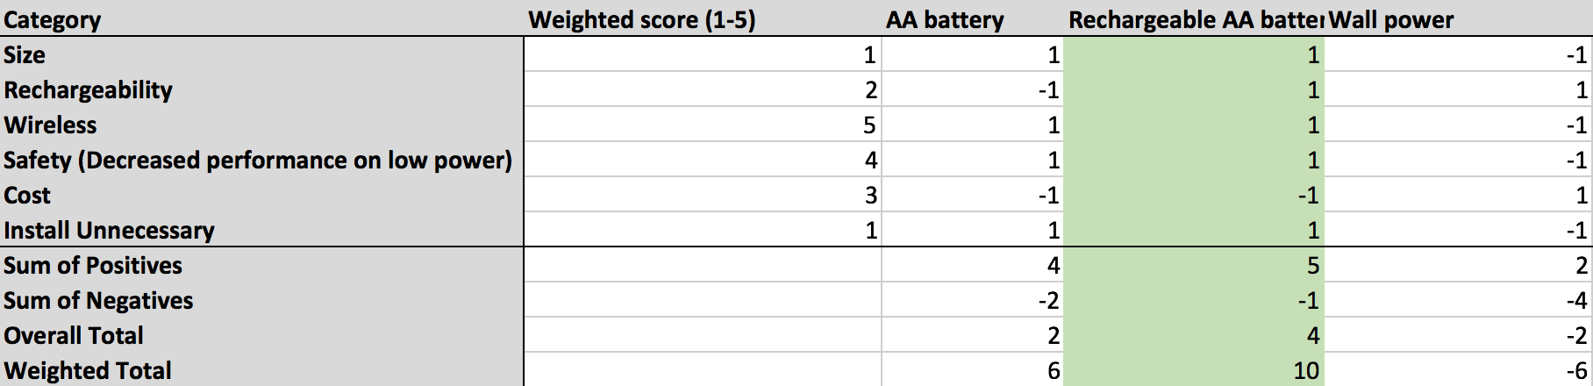
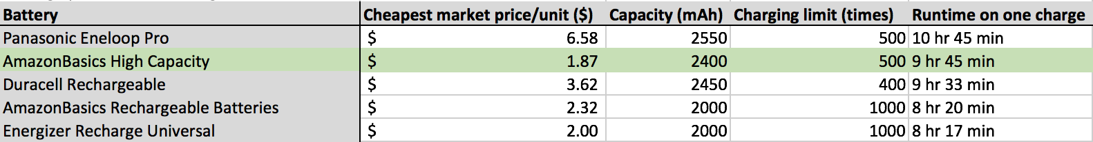
Objectives: Battery v Main Wall Power

Slide 6
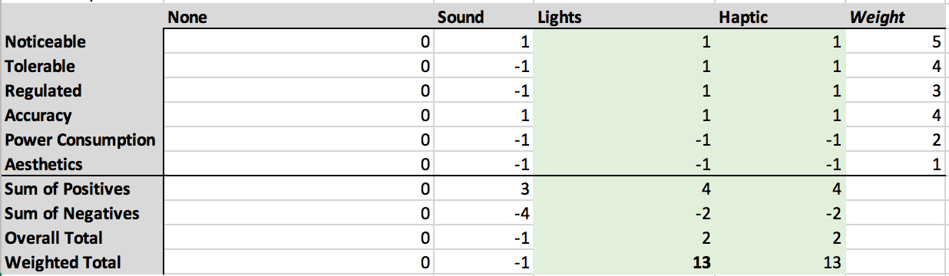
Objectives: User Alert

Slide 7
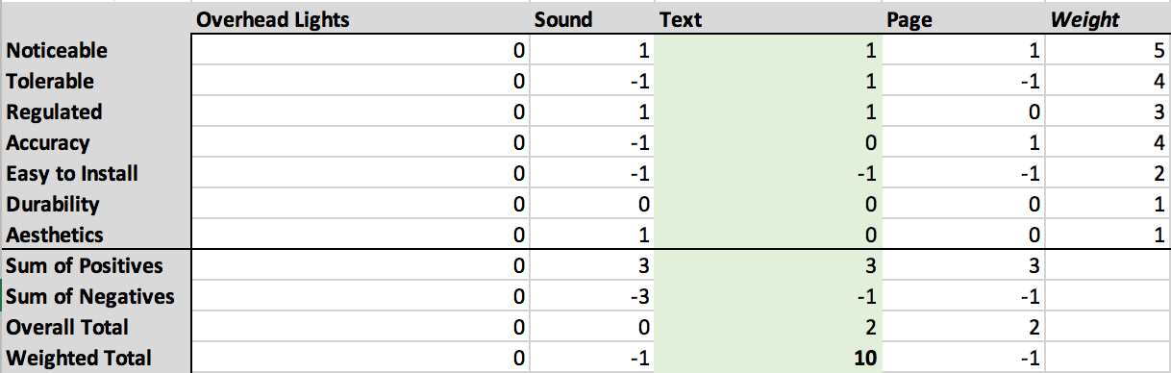
Objectives: Nurse Alert

Slide 8
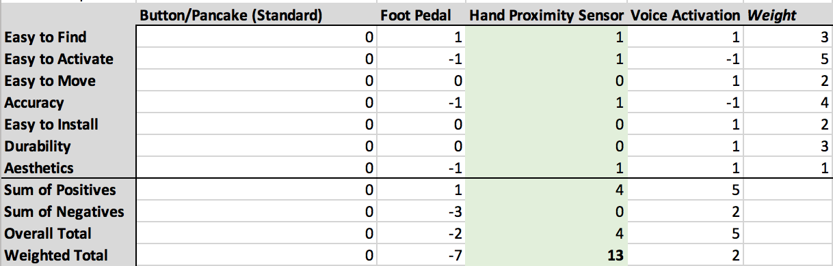
Objectives: User Input

Slide 9
Objectives: Bluetooth and Wifi Regulations
The hospital currently..
“[uses] analytics tools and other third party technologies … to collect non-individual information in the form of various usage and user metrics when the user employs these services.”
Duke Health Notice of Privacy Practices
Our device does not generate protected health information as defined in HIPAA Part 164 Security and Privacy Subpart C.

Slide 10
Objectives: Bluetooth and Wifi Regulations
On general security of wireless signal and data, our device must provide:
Access control
Encryption
HIPAA-compliant Wifi satisfies Administrative (office processes and policies), Physical (hardware) and Technical (securing WLAN traffic) Requirements.
Bluetooth Security: Provides 128-bit SAFER+ encryption and authentication. Controllable discovery and connectability modes control access.

Slide 11
Objectives: Bluetooth and Wifi Regulations
On general security of wireless signal and data, our device must provide:
Access control
Encryption
HIPAA-compliant Wifi satisfies Administrative (office processes and policies), Physical (hardware) and Technical (securing WLAN traffic) Requirements.
Bluetooth Security: Provides 128-bit SAFER+ encryption and authentication. Controllable discovery and connectability modes control access.

Slide 12
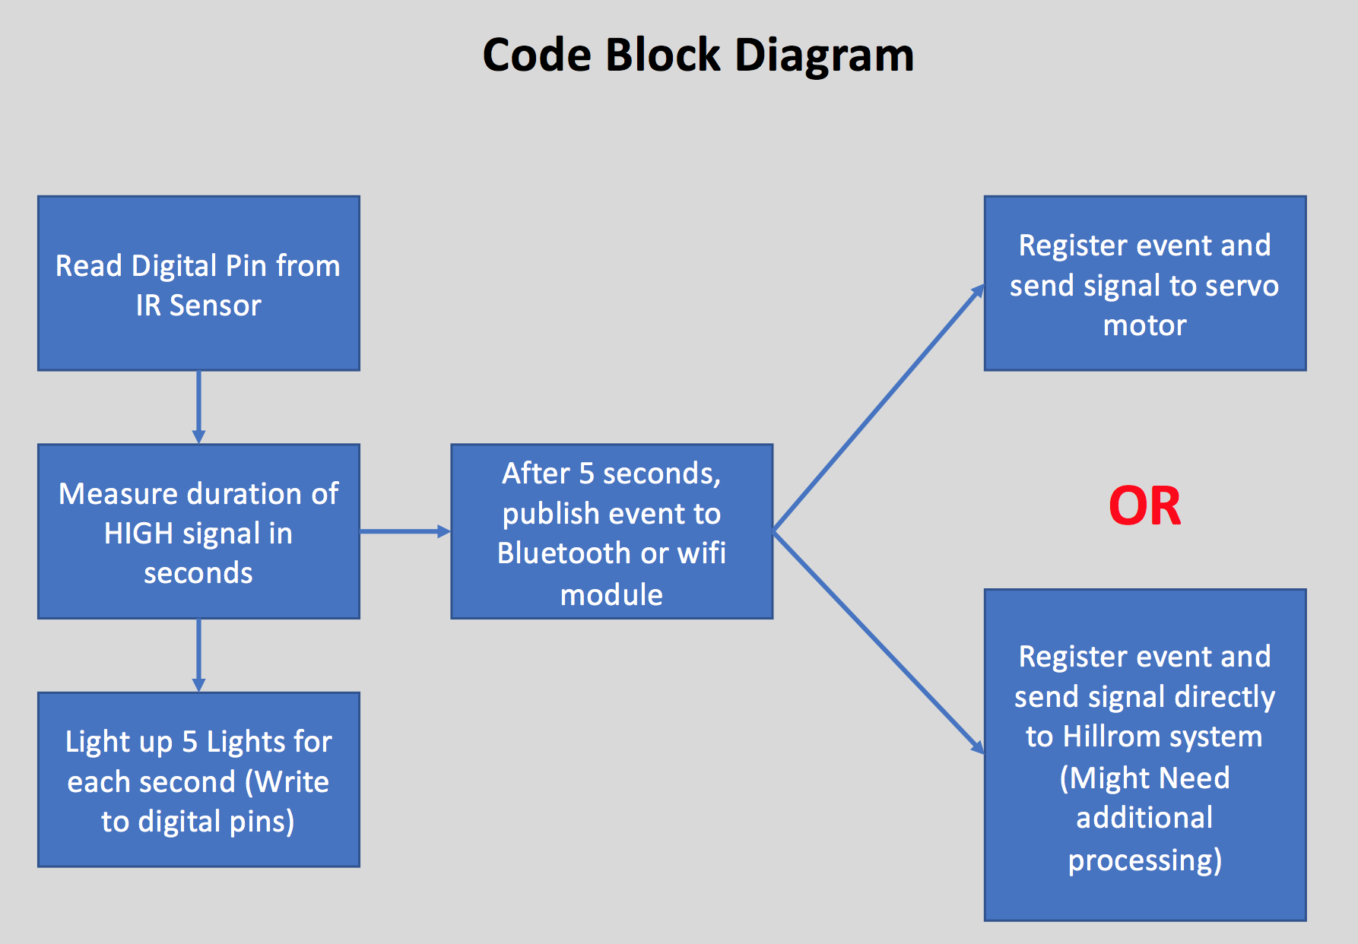
Prototyping Objectives: Code Block Diagram

Slide 13
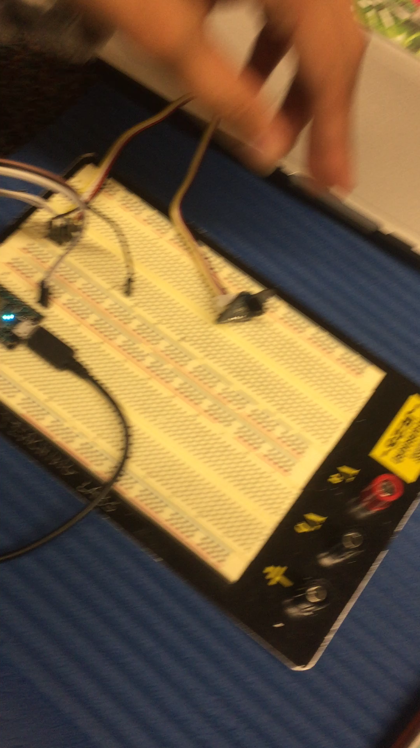
Prototyping Objectives: Working Device

Slide 14
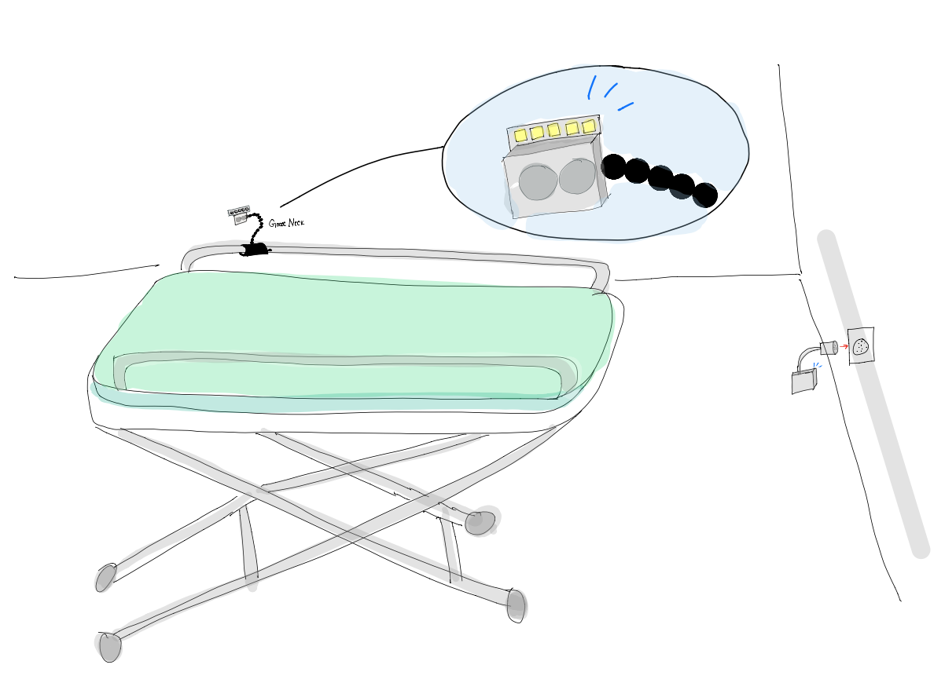
Prototyping Objectives: Drawings
Notes:
Liz add screenshots of solidworks files

Slide 15
Next Steps and Conclusion

